Slide 1
Image Processing Coin Detection to Estimate the Total Value of the Coins in an Image Using OpenCV
DIALLO Mamadou Yaya Chérif
KANCHERLA Manideep Reddy
Master 1 – Computer Vision & Intelligent Machines

Slide 2
Index
Introduction
Objectives
Materials & Methodology
2.1. Materials & Datasets
2.2. Image Processing
2.3. Value Estimation
Results and Discussion
3.1. Results
3.2. Discussion
Conclusion

Slide 3
Introduction
Shift towards electronic transactions -> Eliminate the tedious task of counting coins
Huge array of techniques and approaches: Artificial neural networks, Heuristics approach, sensors etc.
Our Approach: Circular Hough approach and estimating the coin values based on circle radii

Slide 4
1.Objectives
Implement our approach:
Develop an effective methodology for Circular Hough transform
Develop a method to estimate the coin values using radius of the detected circles
Discover other usable approaches and add further functionalities (including colour as an additional metric)
Understanding our limitations at the end in order to further optimize our proposed approach

Slide 5
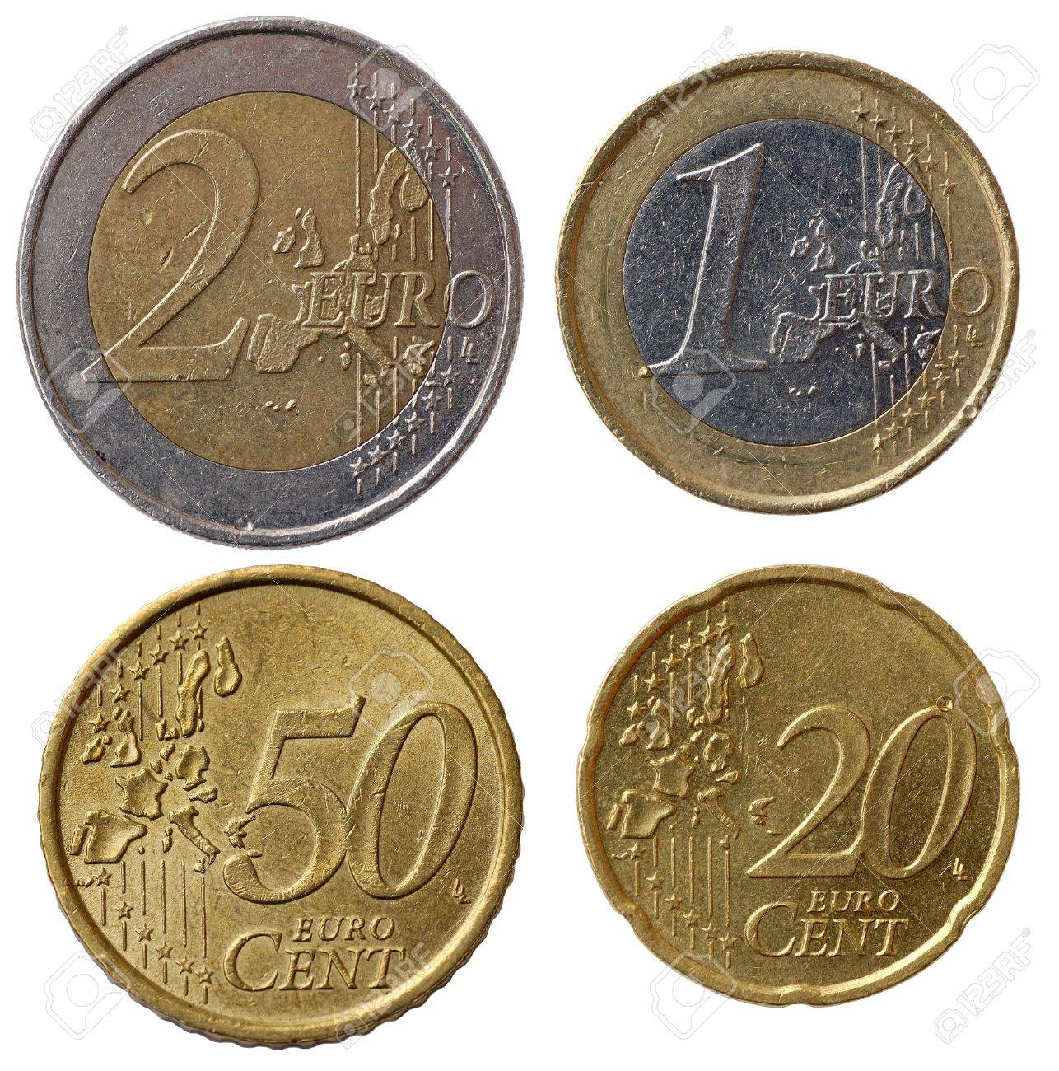
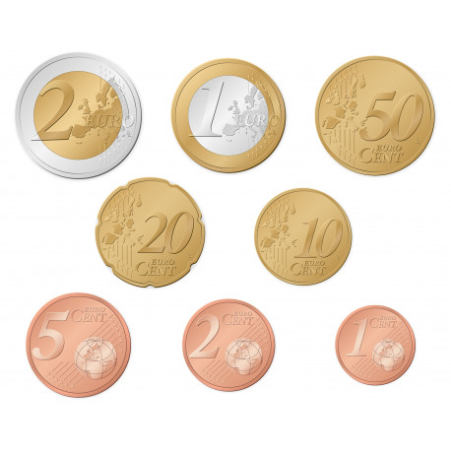
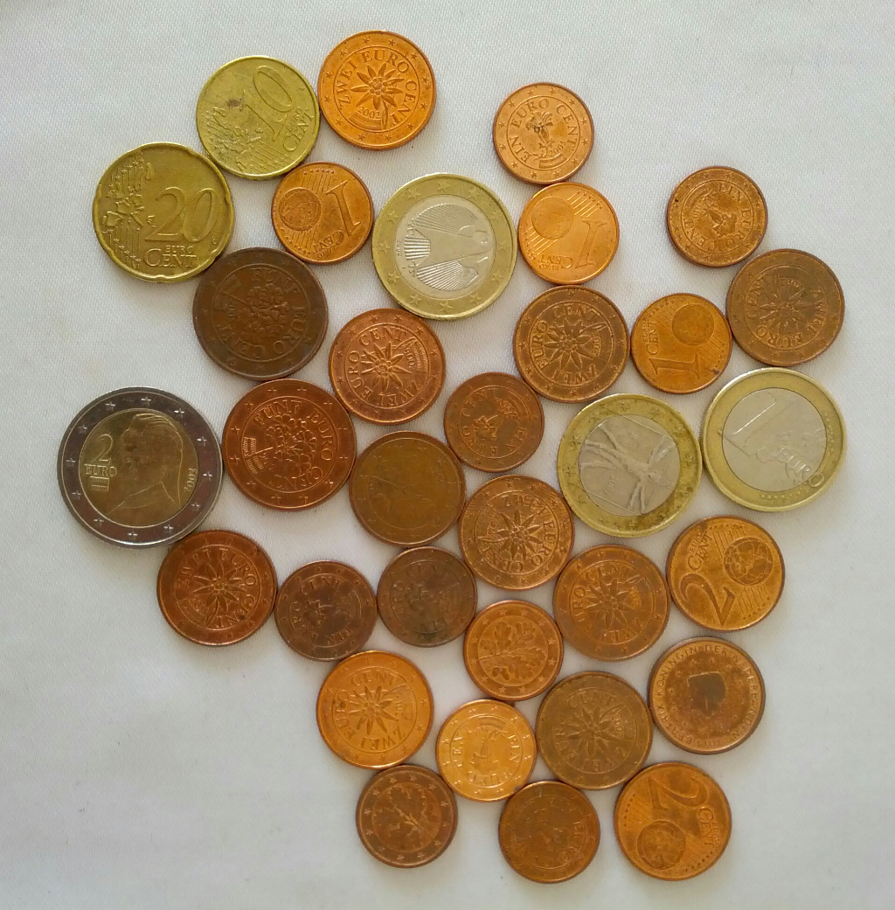
2.1. Materials and Datasets
2.Materials and Methodology
Laptop Specifications:
AMD Ryzen 7 4800H with Radeon Graphics 2.90 GHz
16,0 GB RAM (15,4 GB usable)
IDE: Visual Studio using OpenCV
Language: C++
Comparative study of three different images with an increasing number of coins in each image
Dataset for training and trail & error testing – an image with 8 coins of all the available coins
Datasets for testing – Three different images with 4 coins, 8 coins, and 33 coins respectively

Slide 6
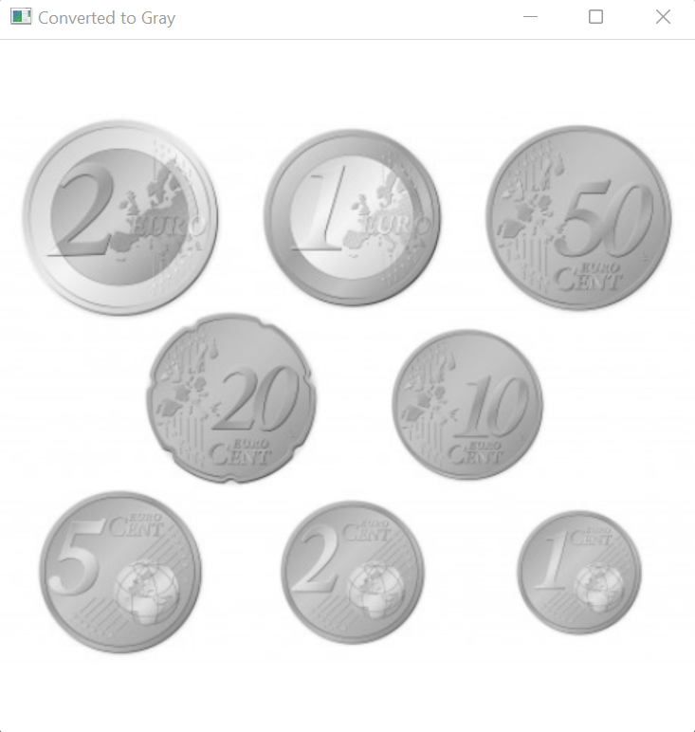

2.2. Image Processing
2.Materials and Methodology
Convert to Gray
To simplify the algorithm and computational demands by providing less information for each pixel
Median filtering
To filter out noise and smoothen the image by using the median of the neighbouring pixels

Slide 7
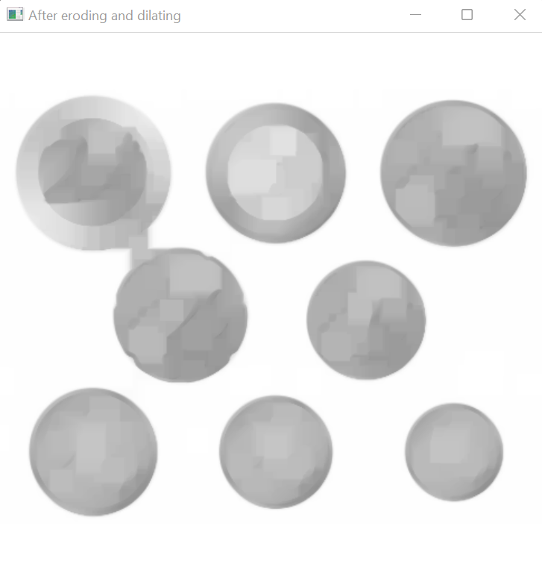
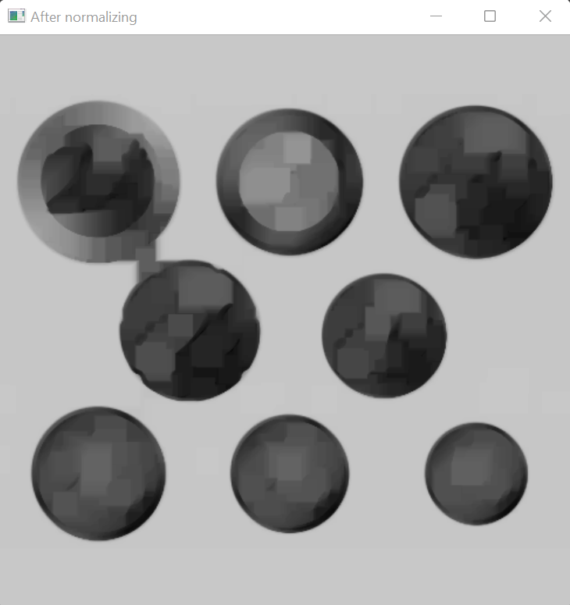
2.2. Image Processing
2.Materials and Methodology
Morphological operation to process images based on shapes
Erosion: Erodes the boundaries of the foreground object and diminishes the features of an image
Dilation: Increases the object area and accentuates the features
Erosion is followed by dilation
Normalization
To change the intensity level of pixels and get a better contrast in images

Slide 8
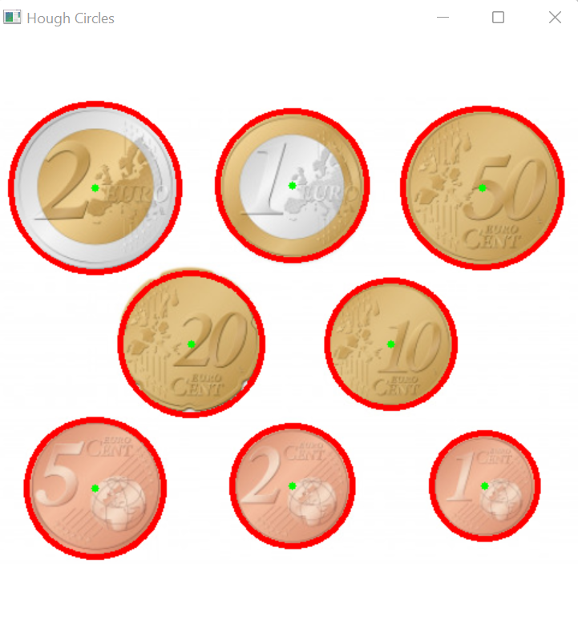
2.2. Image Processing
2.Materials and Methodology
Circular Hough Transformation
Used to find circles in an image and is represented by it’s centre and radius r of the circle
Arguments used:
Grayscale input image
Circles (coins in our code): A vector that stores sets of 3 values: xc, yc, r for each circle
HOUGH_GRADIENT: The detection method available in OpenCV
dp = 1 – Inverse ratio of resolution
Min_dist = (img_gray.rows / 16) – Minimum distance between detected centres
Param_1 = 100 – Upper threshold for the internal Canny edge detector
Param_2 = 30 – Threshold for centre detection
Min_radius = 1 – Minimum radius to be detected.
Max_radius = (img_gray.rows / 4) – Maximum radius to be detected

Slide 9
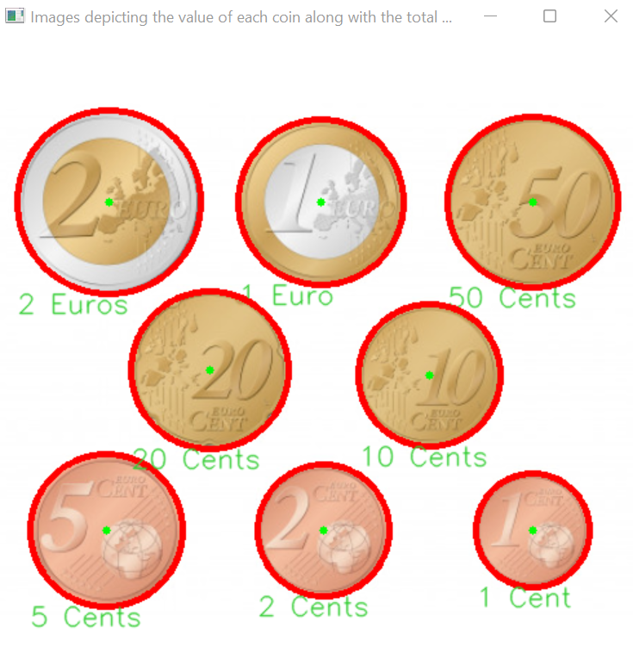
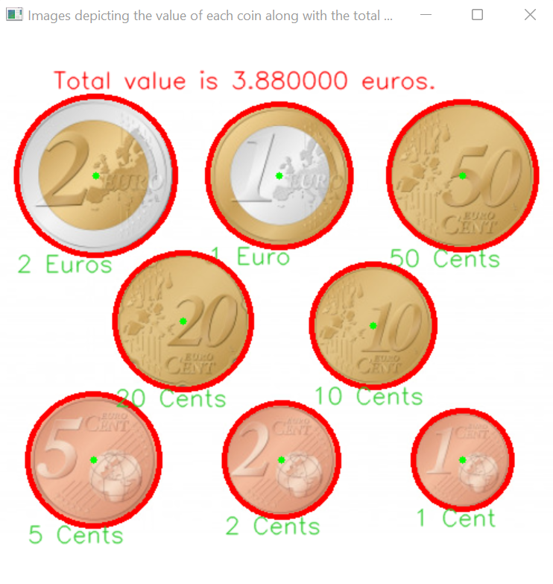
2.3. Value Estimation
2.Materials and Methodology
COINS | DIAMETER (mm) | Ratios (adjusted)
1 Cent | 16.25 | > 0.6 & <= 0.675
2 Cents | 18.75 | > 0.675 & <= 0.75
5 Cents | 21.25 | > 0.8 & <= 0.84
10 Cents | 19.75 | > 0.75 & <= 0.8
20 Cents | 22.25 | > 0.84 & <= 0.875
50 Cents | 24.25 | > 0.925 & <= 0.975
1 Euro | 23.25 | > 0.875 & <= 0.925
2 Euros | 25.75 | > 0.975
Value detection using the circle radius with 2 euros coin considered as the highest value:
Identify the coin with the highest diameter
Use real life measurements (theoretical value found on the internet) to calculate the ratio (radius of the given coin / largest radius) between diameters of any given coin and the one with the highest diameter
Compare the real life ratios with ratios computed using the processed image in order to the detect the coin value for each of the detected circles
Finish by displaying the coin values on the original image
Display the total value of coins on the screen

Slide 10
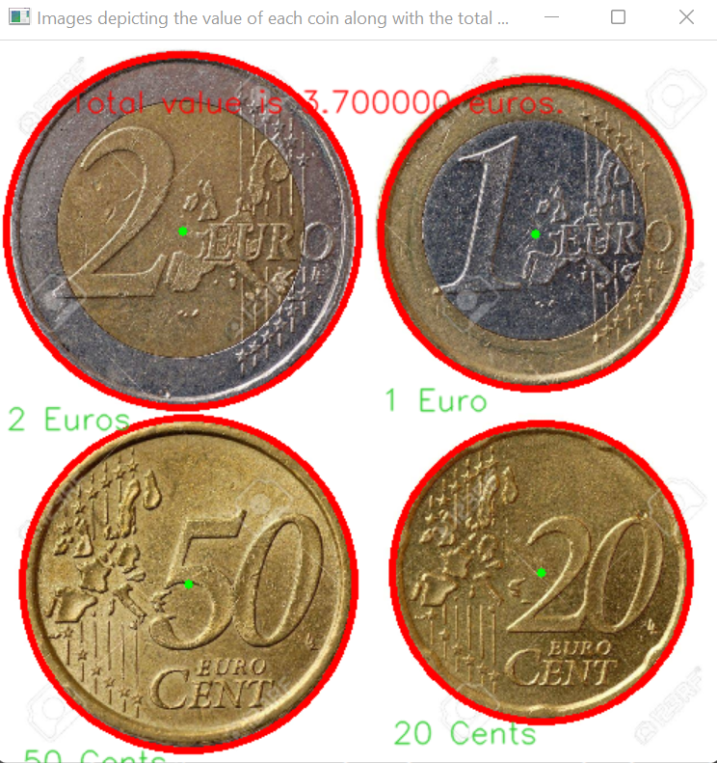
3.1. Results
3.Results and Discussion
The final processed image with smaller (4) number of coins (500x500) has the following accuracy results:
~100% accuracy in terms of coin detection
~100% accuracy in terms of value detection
The final processed image with the medium (8) number of coins (500x500) has the following accuracy results:
~100% accuracy in terms of coin detection
~100% accuracy in terms of value detection

Slide 11
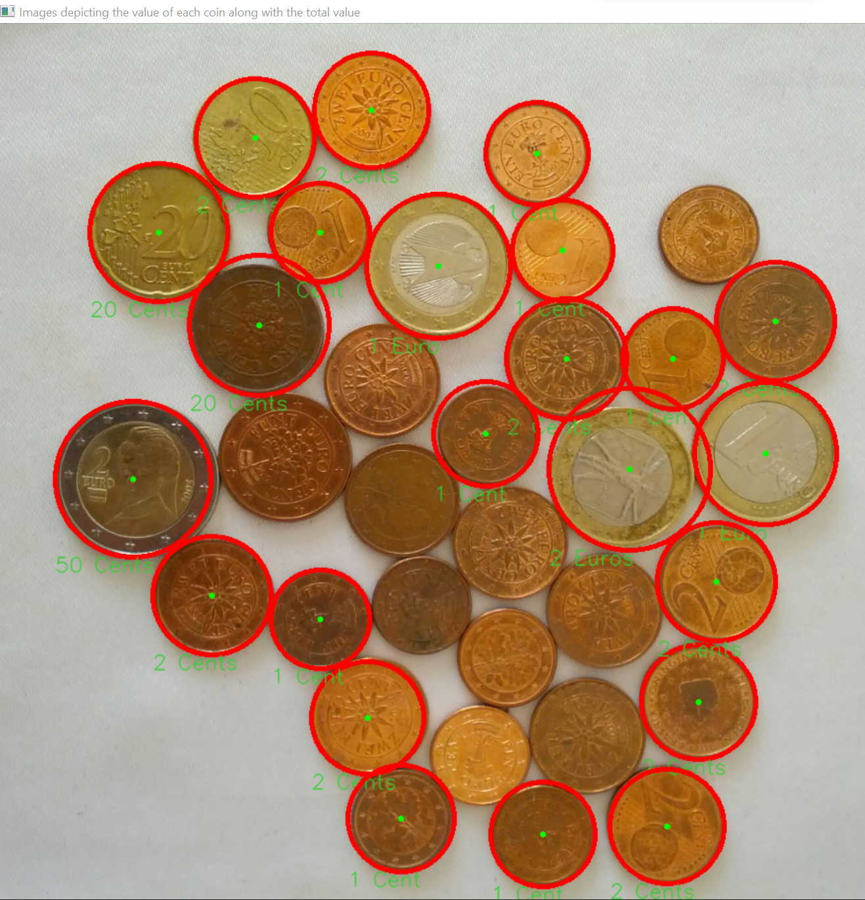
3.1. Results
3.Results and Discussion
The final processed image with the most (33) number of coins (900x900) has the following accuracy results:
~70% accuracy in terms of coin detection
~61% accuracy in terms of value detection

Slide 12
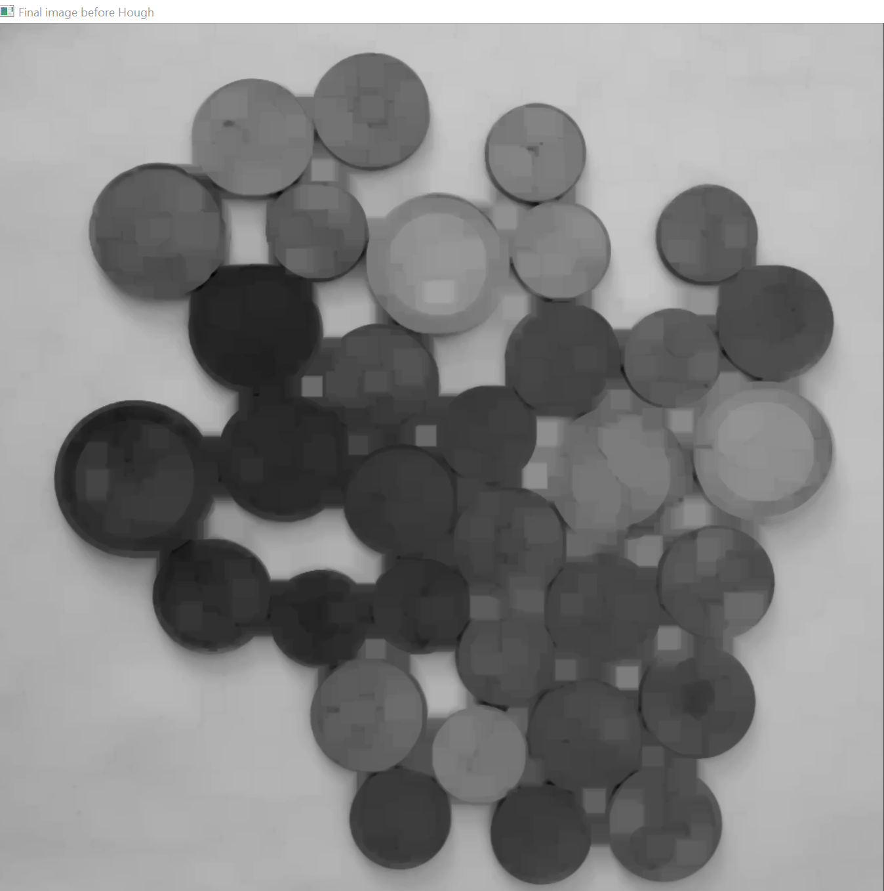
3.2. Discussion
3.Results and Discussion
Images with large number of coins experienced the most difficulties
This may be due to:
Coins being too close to each other
Boundary confusion after the image goes through morphological operation (erosion and dilatation)
Confusion in identifying coins when the ratios are very close
We need to know beforehand the coin with the largest radius -> tedious and inefficient
After Hough Transformation

Slide 13
Conclusion
Elaborate methodology to detect coins with the Circular Hough approach and identifying the coin values using the radius of Hough circles
Limitations in detecting coins on an image containing large number of coins stacked together
Need for a better classification tool than the ratio of the radii because we need to know the largest coin beforehand and compute ratios based on it
Improve by adding colour as an additional feature and a comparative metric
Future work in the direction of addressing the limitations and testing more use cases, along with working with other coin detection approaches using neural networks, sensors etc.

Slide 14
Thank You For Your Attention !!!

